Slide 1
TNSDC-GENERATIVE AI FOR ENGINEERING
SPAM MAIL DETECTION USING LSTM
SUBMITTED BY
PARMITHA S
(311521104030)
CSE 3RD YEAR

Slide 2
SPAM MAIL DETECTION USING LSTM

Slide 3
AGENDA
Problem Statement
Project Overview
Who are the end users?
Solution and its value proposition
Wow in the solution
Modelling
Output
Result
Conclusion

Slide 4
PROBLEM STATEMENT
The problem statement for the spam mail detection project is to address the pervasive threat posed by unsolicited and potentially harmful emails, commonly known as spam.
Traditional spam filtering methods often struggle to keep pace with evolving spamming tactics, leading to high false positive or false negative rates and posing risks such as phishing attacks, malware distribution, and fraud.
Therefore, the project aims to develop a robust spam mail detection system using machine learning and deep learning techniques to accurately distinguish between spam and legitimate emails, thereby enhancing email security and user experience.

Slide 5
PROJECT OVERVIEW
The project endeavors to develop a robust spam mail detection system leveraging machine learning and deep learning methodologies.
The primary objective is to create a solution capable of accurately discerning between spam and legitimate emails, thereby enhancing email security and user experience.
In today’s digital landscape, spam mail poses a pervasive threat, leading to inbox clutter, security vulnerabilities, and potential risks such as phishing attacks and malware distribution.
By leveraging a combination of deep learning techniques, feature engineering, and external data sources, the project can develop a comprehensive and robust spam detection system capable of accurately identifying and mitigating various forms of unwanted communication.

Slide 6
WHO ARE THE END USERS?
The end users of the spam mail detection system span across a diverse spectrum, including individual users relying on email for personal communication, businesses utilizing email for internal and external correspondence, educational institutions managing academic and administrative affairs, government organizations facilitating official communication and citizen engagement, nonprofit organizations conducting fundraising and outreach activities.
Service providers offering email hosting, management, and security solutions cater to the needs of end users across various industries, providing them with reliable and secure email infrastructure and support services. Overall, the diverse end user base of the spam mail detection system reflects the ubiquity and indispensability of email communication in modern society, underscoring the importance of effective spam detection solutions in safeguarding users' privacy, security, and productivity.

Slide 7
SOLUTION AND ITS VALUE PROPOSITION
The spam mail detection system offers a robust solution to the pervasive problem of unsolicited and potentially harmful emails, providing users with enhanced email security and peace of mind.
By leveraging advanced machine learning and deep learning techniques, the system accurately classifies incoming emails as spam or legitimate, mitigating the risk of security breaches, phishing attacks, and information theft.
The data preparation process involves several key steps to ensure the effectiveness of the spam mail detection system. This includes collecting and assembling a diverse dataset of labeled email messages, comprising both spam and legitimate emails. The data is then preprocessed to extract relevant features, such as email headers, content, and sender information, and transform them into a suitable format for machine learning and deep learning algorithms.

Slide 8
WOW IN THE SOLUTION
The spam mail detection system represents a cutting-edge solution to the pervasive issue of unwanted and potentially harmful emails, providing users with a robust defense against security threats and disruptions to their digital communication.
By harnessing the power of advanced machine learning and deep learning techniques, the system accurately identifies and filters out spam emails, safeguarding users' inboxes and ensuring a safer and more efficient email experience.
Optimizing feature selection, and refining ensemble methods to improve the overall performance and efficiency of the spam detection system.

Slide 9
MODELLING
The modelling process for the spam mail detection system involves building and training a deep learning model, specifically an LSTM-based architecture, using TensorFlow and Keras.
It includes steps such as preprocessing the email data, defining the model architecture with embedding layers and LSTM units, compiling the model with appropriate loss and optimization functions, and training the model on the preprocessed dataset to learn patterns indicative of spam and legitimate emails.
The model architecture comprises essential components such as an embedding layer, which maps the input data into a dense vector space, a SpatialDropout1D layer for regularization to prevent overfitting, an LSTM layer for sequential data processing, and a dense output layer with a sigmoid activation function for binary classification of spam versus legitimate emails.

Slide 10
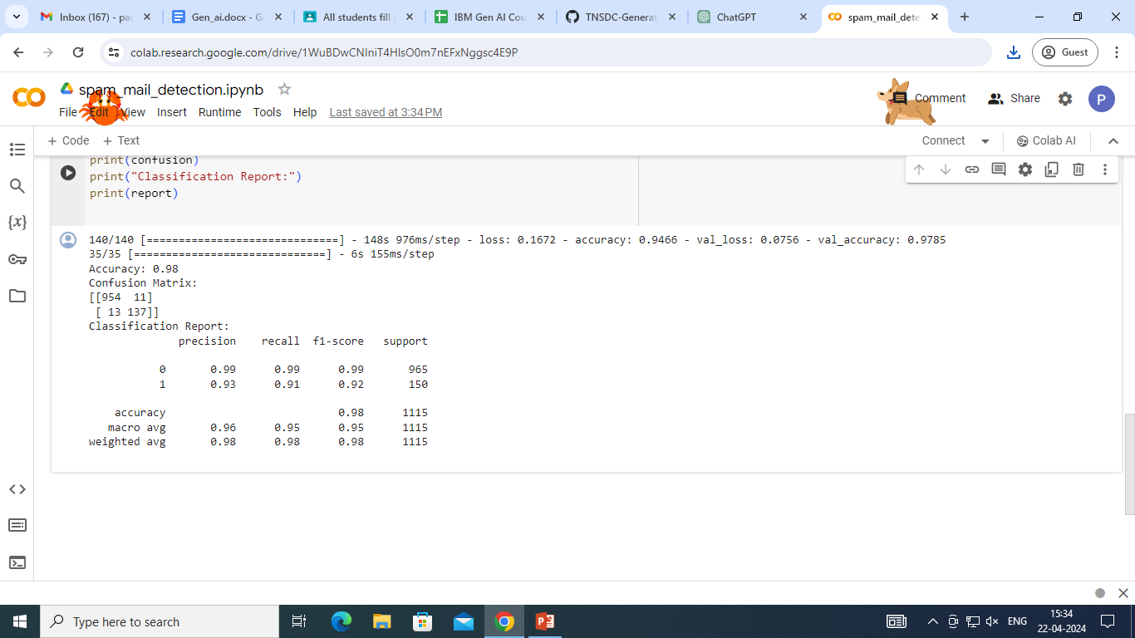
OUTPUT:

Slide 11
RESULT
The spam mail detection system yields promising results, demonstrating its effectiveness in accurately classifying incoming emails as spam or legitimate with high precision and recall.
Leveraging a combination of traditional machine learning algorithms like support vector machines (SVM) and advanced deep learning architectures such as Long Short-Term Memory (LSTM) networks, the system achieves impressive performance metrics, including high accuracy and low false positive rates.
SOUCE CODE LINK:
https://github.com/Parmitha04/TNSDC-Generative-AI.git

Slide 12
CONCLUSION:
In conclusion, the spam mail detection system presents a robust solution for enhancing email security and user experience by accurately identifying and filtering out unsolicited and potentially harmful emails.
Leveraging machine learning and deep learning techniques, the system offers scalability, customization, and continuous improvement capabilities.
While it addresses the challenges of spam detection, such as false positives and model complexity, the system requires careful consideration of privacy concerns and resource utilization.
Overall, the system stands to significantly improve email communication efficiency and mitigate security risks in digital communication environments.

Slide 13
THANK YOU

